Slide 1
Chatbot using nlu
SUBMITTED BY,
NAME : S.MUBARAK MOHAMED
REG : 912421104022

Slide 2
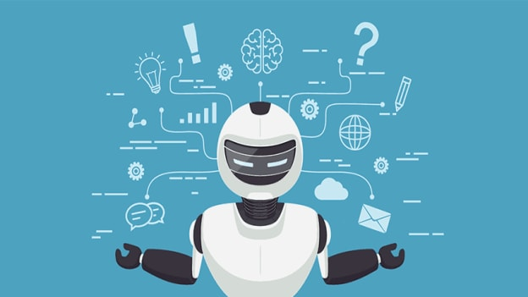

chatbot
A chatbot is a computer program or artificial intelligence (AI) system designed to engage in conversation with users through text or speech interfaces. Chatbots are used to interact with humans in a natural language format, simulating human conversation. They can be found in various applications, including websites, messaging platforms, mobile apps, and customer service portals.

Slide 3

NATURAL LANGUAGE UNDERSTANDING (NLU)
Natural Language Understanding (NLU) is a branch of artificial intelligence (AI) and natural language processing (NLP) that focuses on the ability of computers to comprehend and interpret human language in a way that is meaningful and contextually relevant. NLU enables machines to understand and extract information from textual data, making it possible for them to process and respond to human language inputs in a way that resembles human understanding.
Key components and concepts of NLU include:
Syntax and Grammar Analysis: NLU systems analyze the grammatical structure and syntax of sentences to understand their fundamental components, such as words, phrases, and sentence structures. This analysis helps in identifying relationships between words and their roles in sentences.
Semantic Understanding: NLU goes beyond syntax and aims to understand the meaning of words, phrases, and sentences in context. This involves recognizing the relationships between words, disambiguating word senses, and understanding figurative language and idioms.

Slide 4
Sentiment Analysis: NLU can determine the sentiment or emotional tone expressed in text, classifying it as positive, negative, or neutral. Sentiment analysis is often used for social media monitoring, customer feedback analysis, and brand reputation management.
Intent Recognition: NLU can discern the intention or purpose behind a text or speech input. This is particularly useful for chatbots and virtual assistants, allowing them to understand and respond appropriately to user queries.
Coreference Resolution: NLU systems resolve coreferences, which means identifying when pronouns (e.g., "he," "she," "it") or other referring expressions in a text refer to specific entities mentioned earlier in the text.
Contextual Understanding: NLU takes into account the context of a conversation or a document to provide meaningful responses. This involves maintaining context across multiple interactions and understanding how prior messages or sentences influence the interpretation of new ones.
Machine Learning and Deep Learning: NLU systems often employ machine learning and deep learning techniques to improve their understanding of language. These methods enable the system to learn from large datasets and adapt to different language patterns and domains.

Slide 5
CHATBOT USING NLU
Natural Language Understanding (NLU) is a fundamental component of chatbots and virtual assistants. Chatbots use NLU to comprehend and respond to user inputs in a natural and contextually relevant manner. Here's how NLU is integrated into chatbots:
User Input Understanding: When a user interacts with a chatbot by sending a text or voice message, the chatbot's NLU component analyzes the input to understand the user's intent, entities mentioned, and the context of the conversation.
Intent Recognition: NLU identifies the primary purpose or intention behind the user's message. For example, if a user asks a weather chatbot, "What's the weather like today in New York?" the NLU system recognizes the intent as a weather query.
Entity Extraction: In addition to recognizing the intent, NLU can extract specific pieces of information called entities. In the example above, "New York" would be recognized as a location entity. This extraction helps the chatbot provide accurate responses.

Slide 6
Context Management: NLU also helps in managing the context of the conversation. It understands previous user inputs and responses, allowing the chatbot to maintain a coherent and context-aware dialogue. Contextual understanding ensures that the chatbot can respond accurately to follow-up questions or clarifications.
Intent Mapping: After recognizing the user's intent and extracting entities, NLU maps the intent to predefined or learned actions or responses. Chatbot developers specify how different intents should be handled, enabling the chatbot to generate appropriate replies.
Response Generation: Once the intent is determined and entities are extracted, the chatbot's response generation component creates a natural language response. This response is then delivered to the user.
Multi-Intent Handling: NLU can also handle cases where a user's message contains multiple intents or questions. The system can prioritize and process these intents in a meaningful order.
Sentiment Analysis: NLU can analyze the sentiment expressed in user messages, allowing chatbots to respond with appropriate emotional tone and empathy, especially in customer service applications.
Learning and Improvement: NLU in chatbots can be powered by machine learning algorithms, enabling the chatbot to learn and improve its understanding over time through user interactions and feedback.

Slide 7
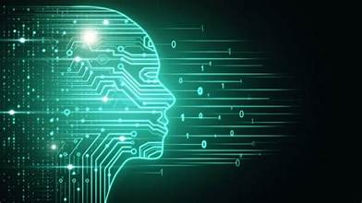
FEATURES
Implementing advanced features like Natural Language Understanding (NLU) is a crucial step in improving the accuracy of user intent recognition in chatbots, virtual assistants, or other natural language processing (NLP) applications. NLU allows your system to understand and interpret user queries with a higher level of sophistication, leading to more effective interactions. Here's how you can leverage advanced NLU for improved user intent recognition:
Use Pretrained NLU Models: Utilize pretrained NLU models that have been trained on large, diverse datasets. These models, such as BERT (Bidirectional Encoder Representations from Transformers) or GPT (Generative Pre-trained Transformer), can capture complex language patterns and semantics.
Intent Recognition: Implement intent recognition models that are designed to identify user intentions. These models can categorize user queries into specific intent categories, enabling the system to understand what the user wants to achieve.
Entity Recognition: Employ entity recognition models (NER) to identify key entities within user queries. This helps extract specific pieces of information from the text, making it easier to fulfill user requests accurately.

Slide 8
Contextual Understanding: Enhance your NLU system's ability to maintain context throughout a conversation. This allows the system to remember previous interactions and understand follow-up questions or clarifications.
Multi-Intent Handling: Enable your NLU system to handle conversations that involve multiple intents or topics. Advanced NLU can switch context seamlessly between different intents within the same conversation.
Sentiment Analysis: Implement sentiment analysis to gauge the emotional tone of user queries. This helps tailor responses to the user's mood or sentiment, improving the overall user experience.
Custom Intent and Entity Recognition: Train your NLU models to recognize custom intents and entities that are specific to your domain or application. Customization allows your system to excel in scenarios where generic models may fall short.
Transfer Learning: Use transfer learning techniques to adapt pretrained models to your specific domain. Fine-tuning models on domain-specific data can significantly improve their accuracy in recognizing user intents and entities.
Active Learning and Continuous Training: Implement mechanisms for active learning and continuous model training. Collect user interactions and feedback to retrain your NLU models regularly, ensuring they stay up-to-date and improve over time.
Multilingual Support: If your application has a global audience, ensure that your NLU system supports multiple languages for accurate intent recognition across diverse linguistic contexts.

Slide 9
Fallback Mechanism: Include a fallback mechanism that can gracefully handle queries that the NLU system cannot confidently categorize. This ensures a smooth user experience even when intent recognition is uncertain.
Privacy and Data Security: Ensure that your NLU system complies with data privacy regulations and takes measures to protect sensitive user information.
CONCLUSION
Overall, NLU is a crucial component in chatbot development as it enables chatbots to understand user queries, provide accurate responses, and engage in meaningful conversations. It enhances the user experience by making interactions more human-like and efficient, and it can be applied in various domains, including customer support, information retrieval, e-commerce, and more.

Slide 10
Thank you

